Slide 1
Managing big programs
CS 3335, Fall 2017
Dr. Zhiguang Xu

Slide 2
subjects
Procedural programming paradigm (Part II)
Split the declaration of identifiers from the definition of objects (i.e. functions and/or variables)
Header files
Compilation behind the scenes
Variable and function scopes
Linkage – a property of identifiers
Storage duration – a property of objects
Automate your builds with the make tool

Slide 3
Procedural programming
Break down a programming task into a collection of small tasks and tackle with them one by one as
Self-contained programs/small tools
Reusable functions
Input data are supplied as arguments; output data are produced as return values and/or through pointer arguments.
Data can also be global/shared, the scope of which are presumably specified appropriately .
This is the focus of this segment of the class.

Slide 4
Let’s begin with an example
totaller_orig.c
totaller.c
What’s wrong?
The return type of the function add_with_tax() that the compiler assumes (int) does not match what it finds out later (float). See page 171.
Solution
Force to change the order of how the functions are defined.
Bad idea! What if two functions calling each other?
Splitting the declaration from the definition of functions

Slide 5
Splitting the declaration from the definition of functions
Name(s) of arguments are optional.
Function declaration
float add_with_tax(float f);
totaller_declaration.c
No body code.

Slide 6
Header files
What is even better is to put all function declarations in a header file so they can be reused.
#include is a preprocessor instruction
Difference between “some.h” and <some.h>
Functions returning int don’t have to be declared
totaller.h
totaller_declaration.c
add #include “totaller.h”
Remove the original float add_with_tax(float);

Slide 7
Compilation behind the scenes (pp 184,185)
For each source code file
Preprocessing → still source code
Compilation → assembly code
Assembly → object code
Then, linking (all object and library code) → executable code
An example
encrypt.h, encrypt.c, decrypt.h, decrypt.c, message_hider.c
gcc message_hider.c encrypt.c decrypt.c –o message_hider

Slide 8
Sharing variables
A (global) variable can be defined in one place/file and shared in other places/files, where it is declared extern.
When each file is compiled individually, all the compiler cares about is that all variables have been declared before being used
Then when the linker links all the object files together, it requires that the multiple declarations of the same variable in different files are all mapped to the one and only one definition of it. That is where the memory requirement is eventually being checked for that variable. Finally, when the program is executed, the memory will be actually allocated for that variable according to its memory requirement.
Rule of thumb: define and initialize a global variable in one and only one .c file; declared it with extern in all .h files where such a variable is needed
Let’s see an example (in ch4/sharing_variables/) where the number of function calls is being tracked.
encrypt.c, decrypt.c, message_hider.c
In a separate set of slides, the scope of functions and variables will be studied more formally and in depth.

Slide 9
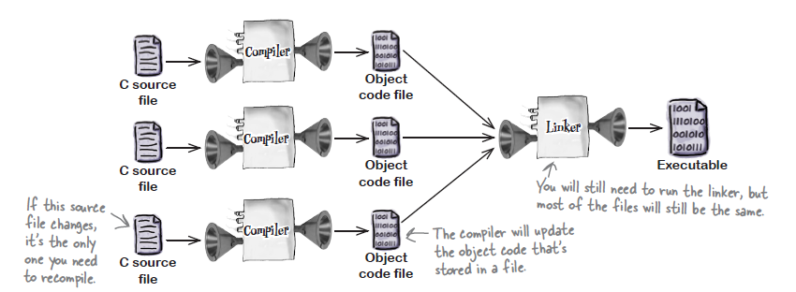
Don’t recompile every file
If only thruster.c (the third .c file) is changed
gcc –c thruster.c
gcc *.o –o launch
But it’s hard and tedious to keep track of all the files, especially when you are working on big programs consisting of many, many files.

Slide 10

Automate your builds with the make tool
make is a tool that automates compilation process. The idea is simple:
make needs to know
The dependencies: which files the target is generated from
The recipe: the set of instructions to run to generate the target
Rules
Stored in makefile or Makefile or othername
Run make
or make –f othername

Slide 11
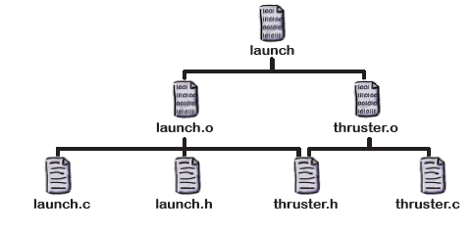
An example
launch.o: launch.c launch.h thruster.h
gcc –c launch.c
thruster.o: thruster.h thruster.c
gcc –c thruster.c
launch: launch.o thruster.o
gcc launch.o thruster.o –o launch
makefile
tab
Makefiles are not script files.
In a separate set of slides, we will learn more about writing makefiles.

